Slide 1


Innovation
in Healthcare
Developing a Unified Patient Treatment Platform for Healthcare Advancement

Slide 2




Meet The Team
SuperNova
Aryan Bains
Divnit Singh
Sneha Singh
Prabhdeep Singh

Slide 3

Healthcare in The 21st Century
Electronic Health Records(EHR) are gaining a lot of popularity all over the world. The current EHR systems however have their fair share of problems related to privacy and security. We have proposed a mechanism which provides a solution to most of these problems by using a permissioned Ethereum blockchain that allows the hospitals and patients across the world to be connected to each other. It gives patients full control over their health records and also allows them to grant or revoke a hospital's access to his/her records. We have used IPFS(inter planetary file system) to store records which has the advantage of being distributed and ensures immutability of records.

Slide 4


Key features
Importance of Medical Records
Medical records are vital for comprehensive patient care, as they contain essential information such as medical history, and required procedures.
Transition to Digital
The medical field has shifted from paper-based record keeping to digitized systems, including EHR Software.
Digital Patient Charts
EHR Software serves as the digital equivalent of traditional paper charts for patients.
Technology-Driven Solutions
EHR Software leverages the latest technologies and tools to provide permanent solutions to various challenges in personal healthcare services.

Slide 5

Technologies used
Introducing a singular, universal database accessible across all hospitals, housing comprehensive patient details and medical records.
Our login credentials boast top-tier security through blockchain encryption, ensuring data integrity.
Patients receive a unique ID for streamlined access to their complete information. Our mission is solely focused on your well-being.
Powered by AWS EC2 bucket on the backend and adorned with a user-friendly JavaScript frontend, our system seamlessly combines robust technology with a commitment to your optimal health.

Slide 6

AI ChatBot
Step into the future of healthcare engagement with our AI-powered chatbot .Seamlessly bridging the gap between technology and patient care, our chatbot is your virtual companion on this digital health journey.
Instantly accessible and intuitively designed, our chatbot stands ready to assist users in navigating their EHR, retrieving medical information, scheduling appointments, and answering queries. With the power of artificial intelligence, it learns and adapts to user preferences, providing a personalized and efficient experience.

Slide 7
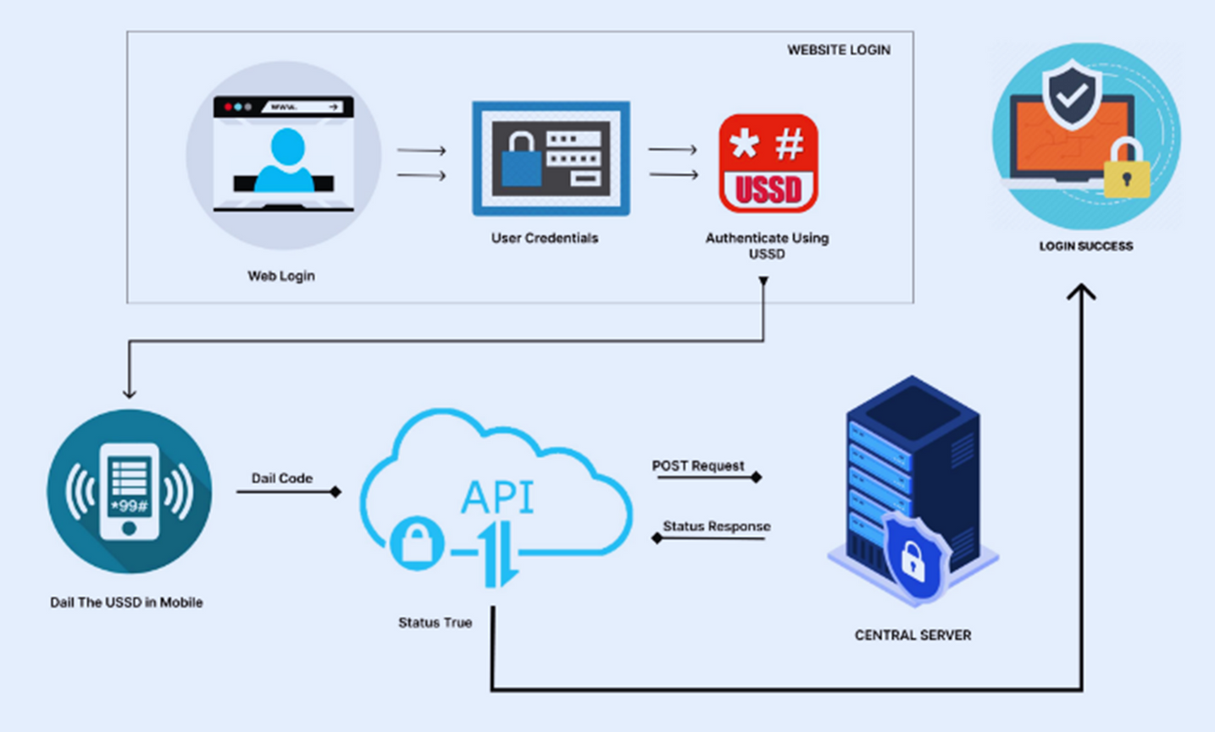
Architecture

Slide 8

AWS Server-Side encryption
Amazon S3 encrypts objects both when saving them on disks in AWS data centers and when decrypting them upon download.
All Amazon S3 buckets come with encryption configured by default.
New objects uploaded to an S3 bucket are automatically encrypted at rest.
The default encryption configuration for every bucket in Amazon S3 is Server-side encryption with Amazon S3 managed keys (SSE-S3).
To use a different type of encryption, you can specify the encryption type in S3 PUT requests or set the default encryption configuration for the destination bucket.
AWS provides resources to help protect critical systems and sensitive data against ransomware.
These resources assist in preparing an organization for a ransomware incident, building a response strategy, and facilitating quicker recovery from such an event.
AWS and the AWS Partner Network offer proactive measures to reduce the risk of a ransomware event.

Slide 9

Advantages
01.
Accurate, quick, and complete data access
02.
Legible documentation free of errors
03.
Diagnoses and care facilities improved greatly
04.
Technology-Driven Solutions

Slide 10
Goal of Innovation
Patient Convenience
empower patients by providing them easy and secure access to their health records. This fosters a more active and informed role for individuals in managing their healthcare journey.
Interoperability and Collaboration
The goal is to break down silos and promote collaboration among healthcare entities. By fostering interoperability, patients can receive more comprehensive care, even when accessing services from various providers.

Slide 11

Future Outlook
Interoperability Advancements:
Objective: Seamless data exchange among different healthcare systems and providers.
Why it Matters: Improved collaboration, holistic patient care, and accessibility of comprehensive health information.
Integration of Artificial Intelligence (AI):
Objective: Integration of AI algorithms for data analysis, predictive analytics, and decision support.
Why It Matters: Enhanced diagnostic capabilities, personalized treatment plans, and proactive healthcare interventions

Slide 12

Conclusion
In conclusion, our website represents a transformative leap into the future of healthcare management. By harnessing the power of cutting-edge technology and thoughtful design, we aim to revolutionize the way health information is handled, ensuring a seamless and secure experience for both patients and healthcare providers.
Through the integration of innovative features such as a unified patient treatment platform, blockchain-secured data, and AI-driven insights, our EHR website not only streamlines administrative processes but also elevates the quality of patient care. The commitment to interoperability fosters collaboration among healthcare entities, creating a connected ecosystem that prioritizes the well-being of individuals.

